Slide 1
UAVSAR LITE
Steven daniels
Sprint 1

Slide 2
Sprint schedule
Design SAR system:
01/15/19-02/15/20

Slide 3
Sprint tasks
Define SAR parameters
Read “Introduction to Airborne Radar (Second Edition) by George W. Stimson

Slide 4
Define sar parameters
An excel spreadsheet will be used to keep track of all SAR parameters. Parameters were separated into 3 categories:
IWR6843AOP Parameters
"Introduction to Airborne Radar" parameters
IWR6843AOP USRR Chirp Configuration Parameters

Slide 5
IWR6843AOP Parameters
IWR6843AOP Parameters
Frequency |  | 60- to 64 | GHz coverage
Wavelength |  | 5 | mm | λ = C/f Where, λ (Lambda) = Wavelength in meters,c = Speed of Light (299,792,458 m/s),f = Frequency
Height of Antenna |  | 10.4 | mm
Length of Antenna |  | 10.4 | mm
Space between Antenna Elements |  | 2.5 | mm
Bandwidth |  | 4 | GHz | 4-GHz continuous bandwidth
Field Of View Azimuth |  | 130 | degrees | 130º azimuth FoV and 130º elevation FoV
Field Of View Elevation |  | 130 | degrees | 130º azimuth FoV and 130º elevation FoV
Azimuth Beamwidth(4Rx, 3Tx in Demo Visualizer) |  | 30 | degrees | https://dev.ti.com/gallery/view/mmwave/mmWave_Demo_Visualizer_IWR6843AOP/ver/1.0.0/
Elevation Beamwidth(4Rx, 3Tx in Demo Visualizer) |  | 30 | degrees | https://dev.ti.com/gallery/view/mmwave/mmWave_Demo_Visualizer_IWR6843AOP/ver/1.0.0/
Azimuth Beamwidth(4Rx, 1Tx in Demo Visualizer) |  | 60 | degrees | https://dev.ti.com/gallery/view/mmwave/mmWave_Demo_Visualizer_IWR6843AOP/ver/1.0.0/
Elevation Beamwidth(4Rx, 1Tx in Demo Visualizer) |  | 60 | degrees | https://dev.ti.com/gallery/view/mmwave/mmWave_Demo_Visualizer_IWR6843AOP/ver/1.0.0/

Slide 6
Introduction to Airborne Radar" parameters
Introduction to Airborne Radar" parameters
2-way 4dB Beamwidth(Uniformally illuminated synthetic array) |  | 0.240385 | radians | wavelength/(2*L), where L = Length of aperture | 13.77302 | degrees
2-way 3dB Beamwidth(Uniformally illuminated synthetic array) |  | 0.211538 | radians | wavelength/(2*L), where L = Length of aperture | 12.12026 | degrees
1-way 3dB Beamwidth(Uniformally illuminated real array) |  | 0.423077 | radians | 0.88(wavelength/L), where L = Length of aperture | 24.24052 | degrees
Null to Null Beamwidth(Uniformally illuminated array) |  | 0.961538 | radians | 2*(wavelength/L), where L = Length of aperture | 55.0921 | degrees
Desired Resolution Cell Size |  |  |  | see "Introduction to Airborne Radar book"
Dimension Azimuth |  | 0.20 | ft | The distance in azimuth of the side of a resolution cell
Dimension Range |  | 0.20 | ft | The distance in range of the side of a resolution cell
Ahievable Resolution Cell Size |  |  |  | see "Introduction to Airborne Radar book"
Dr |  | N/A | ft | 500* t feet where t = compressed pusle width, required bandwidth = 1/t | N/A
Da |  | 61.47541 | mm | (wavelength/2L)*R where L = array length, same units as wavelength | 0.201691 | ft
Max unambiguous range(R) |  | 22500 | mm | This value is the same as USRR Chirp Configuration Parameters max unambiguous range | 73.8189 | ft
Synthetic Array Length(L) |  | 915 | mm | This value was selected to achieve a Da of .2 ft or approx 2 inches | 3.001969 | ft
Da Min(Strip map radar) |  | 5.2 | mm | Length of Real Antenna/2, ultimate resolution for a synthetic array whose beam is positioned at a fixed angle relative to the flight path, as in strip map radars Pg. 415

Slide 7
IWR6843AOP USRR Chirp Configuration Parameters
IWR6843AOP USRR Chirp Configuration Parameters |  |  |  | USRR = Ultra Short Range Radar, take from Texas Instruments document swra553
Max unambiguous range |  | 22.5 | m
Sweep bandwidth |  | 1500 | Mhz
Ramp slope |  | 30 | MHz/us
Inter-Chirp duration |  | 50 | us
Number of chirps |  | 128 | -
Range Resolution |  | 0.1 | m | c/(2*B), where c = speed of light, and B = Sweep bandwidth of FMCW chirp Calculated using matlab
Chirp Duration |  | 50 | us
Max unambiguous relative velocity |  | 35.5 | kmph
Max beat frequency |  | 4.5 | MHz
ADC sampling rate (complex) |  | 5 | Msps
Number samples per chirp |  | 250
Range FFT size |  | 256 | -
Frame time (total) |  | 12.8 | ms
Frame time (active) |  | 6.4 | ms
Radar data memory required |  | 512 | KB | For 1 radar data cube

Slide 8
Read “Introduction to Airborne Radar (Second Edition) by George W. Stimson
Completed chapters: 1,2,3,12,13,30,31,32,33
Important takeaways chapters 1-3
Important takeaways chapters 12-13
Important takeaways chapters 30-33

Slide 9
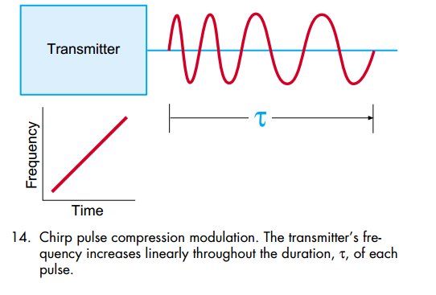
Important takeaways chapters 1-3

Slide 10
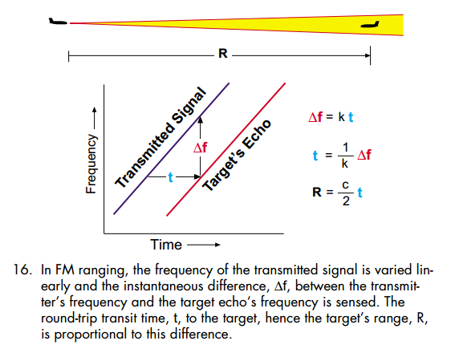
Important takeaways chapters 1-3

Slide 11
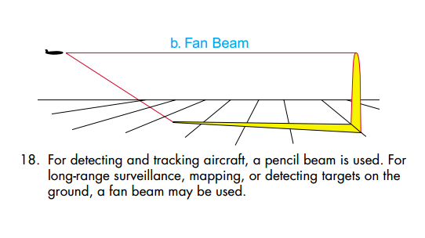
Important takeaways chapters 1-3

Slide 12
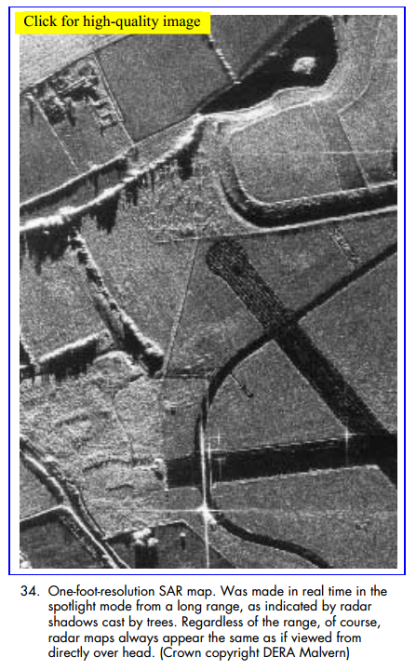
Important takeaways chapters 1-3
Since radio waves are scattered in different amounts by different features of the terrain, a radar can map the ground. With SAR, detailed maps can be made.

Slide 13
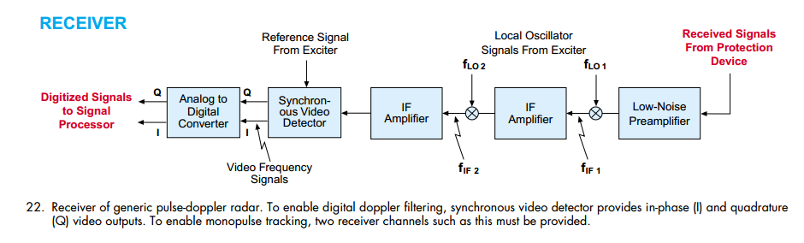
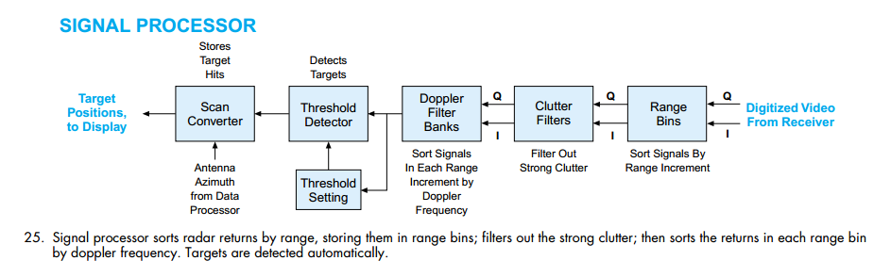
Important takeaways chapters 1-3

Slide 14
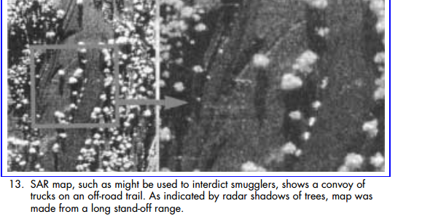
Important takeaways chapters 1-3
Law Enforcement. Both SLAR and SAR have played important roles in oil-spill detection, fishery protection, and the interdiction of smugglers and drug traffickers. Since SAR can provide fine resolution at long ranges, it has the advantage of uncovering illicit activities without alerting the law breakers (Fig. 13).

Slide 15
Important takeaways chapters 12-13
Law Enforcement. Both SLAR and SAR have played important roles in oil-spill detection, fishery protection, and the interdiction of smugglers and drug traffickers. Since SAR can provide fine resolution at long ranges, it has the advantage of uncovering illicit activities without alerting the law breakers (Fig. 13).

Slide 16
retrospective

